Slide 1
Introducing medical store management system(MSMS)
Prepared by :
Sadikshya Chhetri
Susmita Adhikari
Arun Dhakal
Keshab Basnet

Slide 2
Table of Content
Title Introduction Challenges Problem statement Objectives Literature Review Methodology 6.1 Planning Phase 6.2 Requirement analysis phase 6.3 Design phase 6.4 Development phase 6.5 Testing phase 6.6 Flow chart 6.7 Data Flow diagram 7. Conclusion and future Enhancements 7.1 Conclusion 7.2 Future enhancement 8. Results and Outcomes | Page 3 4 5 6 7 8 9 10 11 12 13 14 15 16-20

Slide 3
1: Introduction
Background:
Precise Record keeping is critical in medical store to avoid severe mistakes , but many in Nepal still rely on manual entry risking human error.
Manual data handling makes retrieval and information generation difficult requiring extensive human effort and increasing mistake.
The easy to use medical store management system require no special technical knowledge, making it adaptable for store and enhancing workflow.
A web based medical management system automates Record Keeping, data retrieval and information generation, improving efficiency and data security.

Slide 4
2: challenges in medical store
Ensuring data accuracy and preventing errors is challenging due to high transactions volumes.
Managing inventory, tracking expiry dates require precise coordination.
Adhering to regulations and maintaining records for audits needs continues vigilance.
Integrating with healthcare systems and ensuring seamless data flow is technically complex.

Slide 5
3: problem statement
Reliance on manual record-keeping increase the risk of errors and complicates data retrieval.
Manual inventory management leads to errors, inefficiencies, and potential wastage.
Compliance with regulations and maintaining audit ready records is time consuming without automation.
AIM : Develop An automated medical management system to enhance efficiency and accuracy in record keeping inventory management and regulatory compliance.

Slide 6
4 : objectives
To streamline operations and accurate information management in medical store.
Main Functionalities:
Manage medicines, stocks and sales efficiently.
Digitize operation to save time and resources.
Provide accurate medicines information for informed decisions.

Slide 7
5.Literature Review
Numerous sources were reviewed to gather data on Medical Management Systems, their implementation, and optimization. Key findings highlight the critical role of digital technology, especially post-Covid-19, in enhancing performance, productivity, competitiveness, planning, forecasting, and financial sustainability in various sectors. Information technologies in pharmaceutical enterprises significantly reduce preparation time for marketing and production projects, lower unproductive costs, minimize errors in documentation, and modernize production processes. These points underscore the necessity of technological transformation in the pharmaceutical sector, with Pharmacy Management Systems being a vital component of this shift.

Slide 8
6.Methodology
The development of the medical store management system will follow a
structured methodology to ensure the successful completion of project.
The methodology consist of different phases:
6.1. Planning phase
To develop this medical store management system, at the beginning of the development of this project, all the requirements will be gather and if any changes should be made, it will have the feedback mechanism system too.

Slide 9
6.2 Requirement Analysis Phase
The requirement analysis phase is crucial in the development of a Medical Store Management System (MSMS). This phase involves identifying the needs and expectations of stakeholders, understanding the operational workflows, and defining the functional and non-functional requirements that the system must fulfill. This ensures that the developed system effectively addresses the problems and enhances the overall efficiency of the medical store. In this phase, we will also be studying about the feasibility of the system in the society after the completion of the project on different bases like social feasibility, technical feasibility, time feasibility.

Slide 10
6.3 System Design Phase
We will be designing the overall architecture of the Medical Store Management System which includes designing the user interface to interact with the system. It will be Character/Command Line User Interface (CUI) in which the user will interact with the system through text-based menus.
6.4 Development Phase
The development phase of a Medical Store Management System (MSMS) involves translating the detailed requirements identified during the requirement analysis phase into a functional software application. This phase includes system design, coding, testing, integration, and deployment.

Slide 11
6.5 Testing Phase
The testing phase is a crucial part of the software development lifecycle for a Medical Store Management System (MSMS). This phase ensures that the system is reliable, secure, and performs as expected before it is deployed for actual use. Comprehensive testing helps identify and fix bugs, validate functionality, and ensure that the system meets all specified requirements.

Slide 12
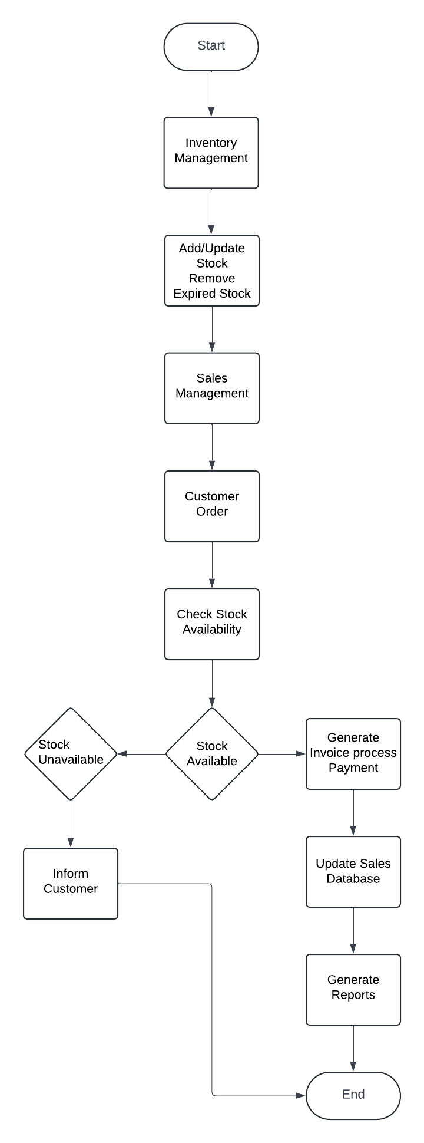
6.6 .Flow chart

Slide 13
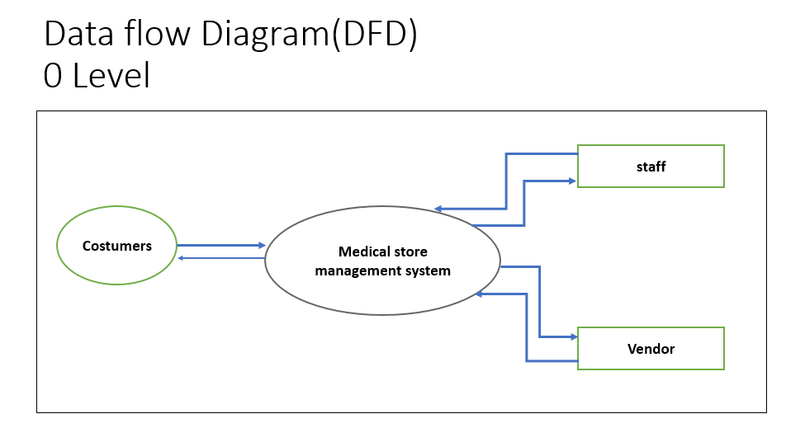
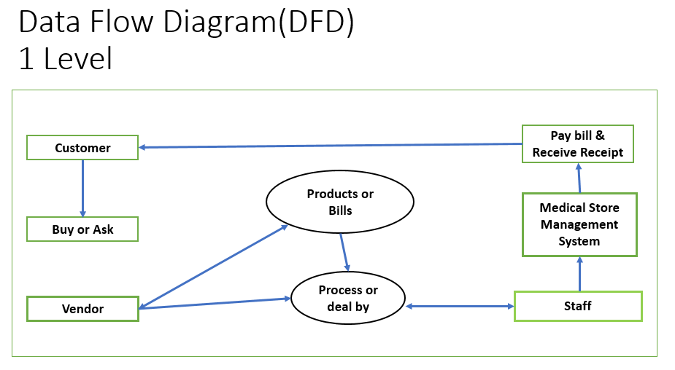
6.8.Data flow diagram

Slide 14
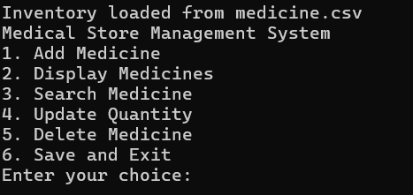
8.Result and Outputs:
Main menu

Slide 15
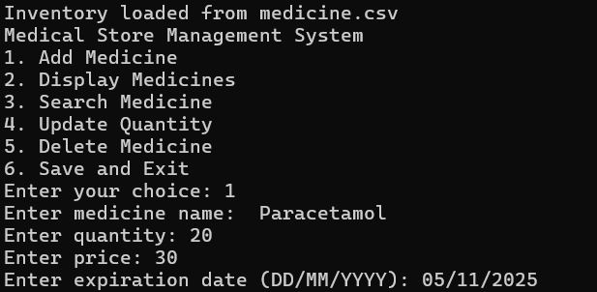
Adding medicine

Slide 16
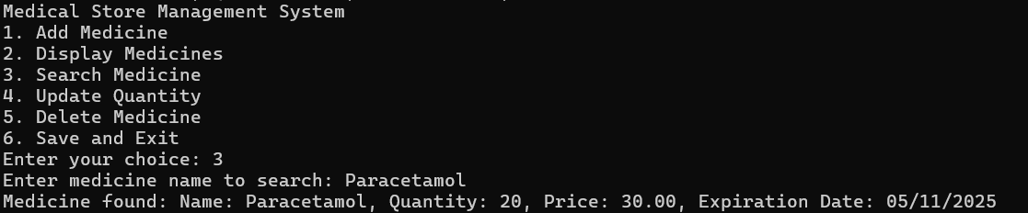
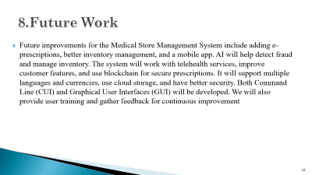
Searching medicine

Slide 17
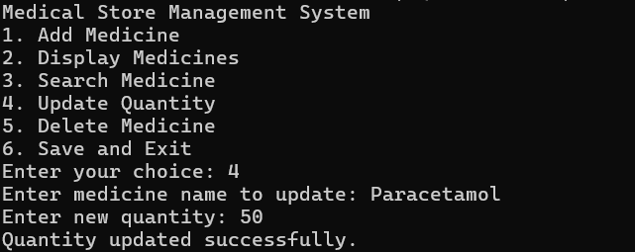
Updating quantity

Slide 18
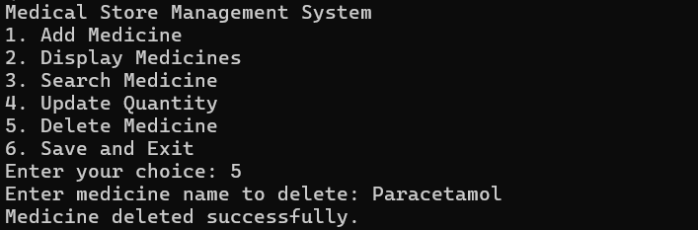
Deleting medicine

Slide 19
8.Future Work
Future improvements for the Medical Store Management System include adding
e-prescriptions, better inventory management, and a mobile app.
The system will work with tele-health services, improve customer features, and use blockchain for secure prescriptions.
It will support multiple languages and currencies, use cloud storage, and have better security. Both Command Line (CUI) and Graphical User Interfaces (GUI) will be developed.
We will also provide user training and gather feedback for continuous improvement

Slide 20

Thank You

